Slide 1
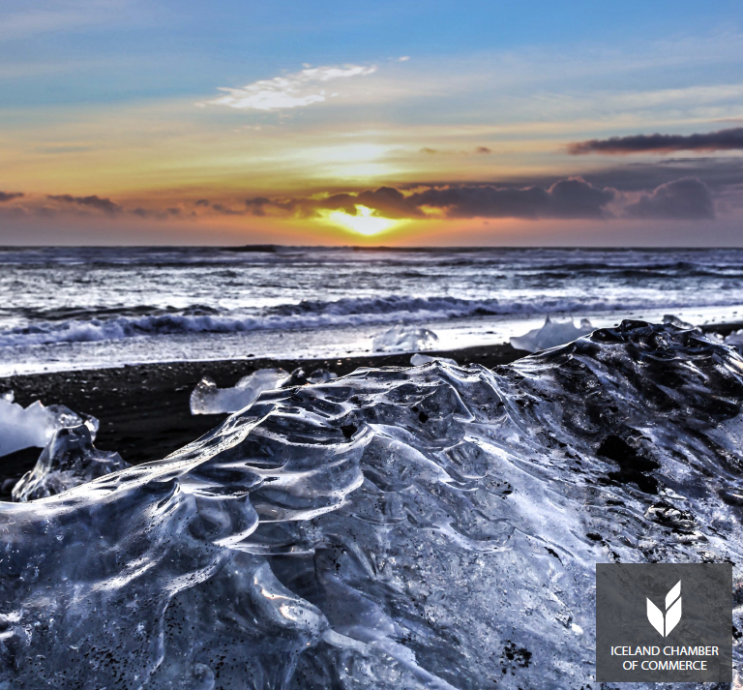
The Icelandic Economic Situation
The Icelandic Economic Situation
Status Report – July 2013
Status Report – July 2013

Slide 2
Overview
  1. Part A – Developments 2012-2013
  2. Part B – The Economic Landscape
  3. Part C – Developments 2009 - 2012
  4. Part D – Future prospects

Slide 3
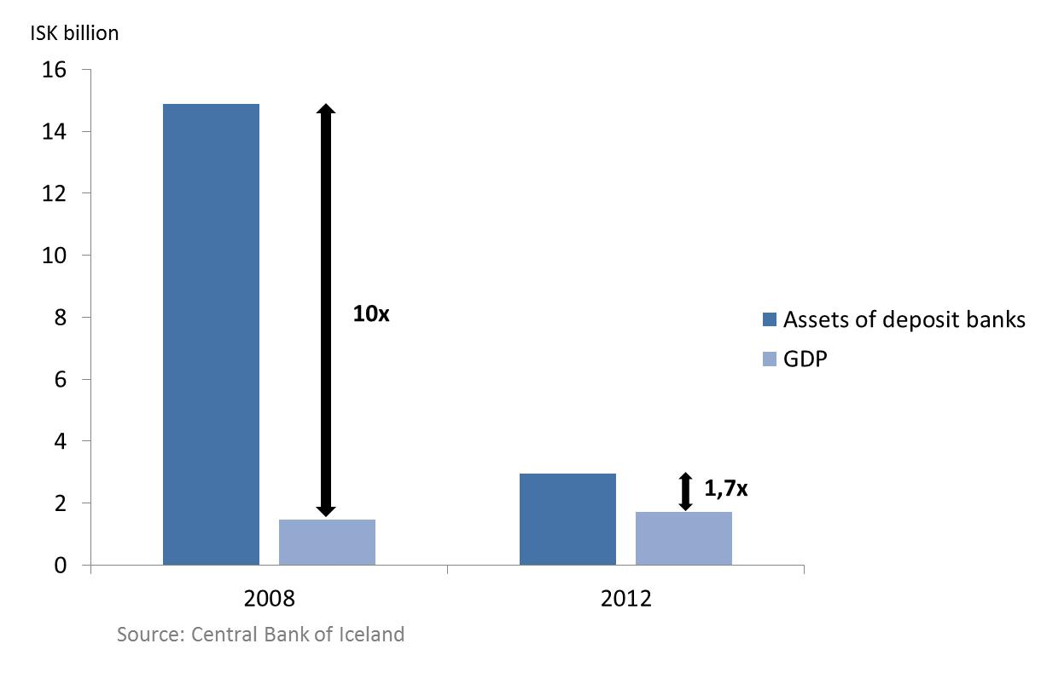
Developments 2012-2013: The Financial Sector
The Financial Sector is significantly smaller than before the crisis
  Not only is the banking system much smaller than before but also simpler. The sector’s stake in Icelandic businesses is significantly lower than in previous years.

Slide 4
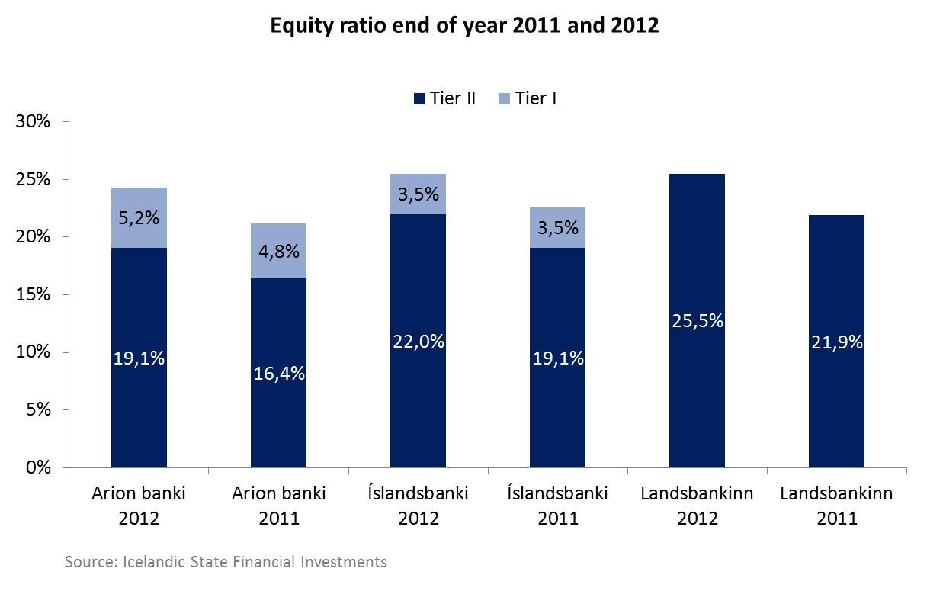
Developments 2012-2013: The Financial Sector
The equity ratio is increasing for all three major banks
  Risk in the financial system has declined in the past year according to the central bank. Nonetheless, the banking sector has yet to reduce further the share of non-performing loans (8%).

Slide 5
Developments 2012-2013: The Financial Sector
Total book value of state‘s holdings in financial institutions amounts to roughly ISK 140 billion

Slide 6
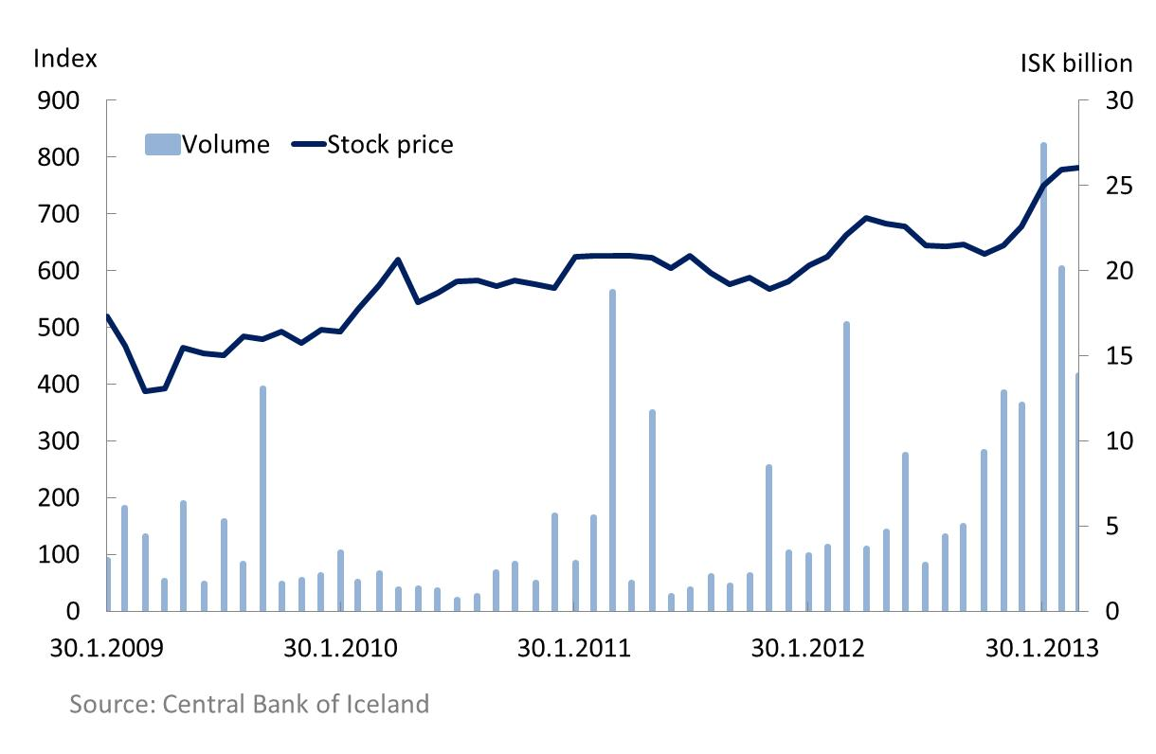
Developments 2012-2013: Economy and the Business Sector
Since the collapse the stock market index has doubled and six new companies have been listed on the stock exchange
  Six new companies:
    Hagar (2011)
    Reginn (2012)
    Eimskip (2012)
    Vodafone (2012)
    VIS Insurance (2012)
    TM Insurance (2012)

Slide 7
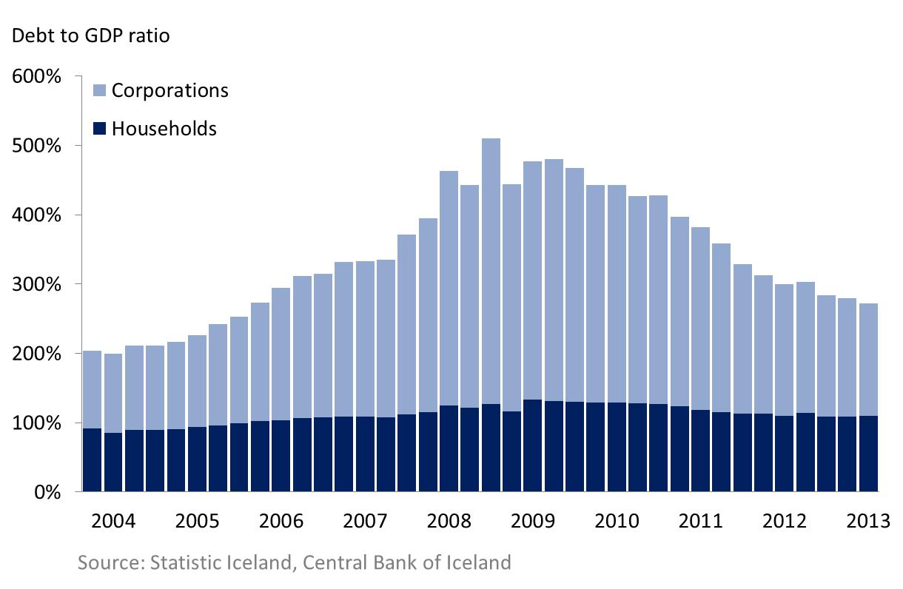
Developments 2012-2013: Economy and the Business Sector
Households‘ and corporations‘ debt had decreased due to debt restructuring
  Corporations debt is down to 162% from peak of 383%
  Household debt is down to 110% from peak of 134%.

Slide 8
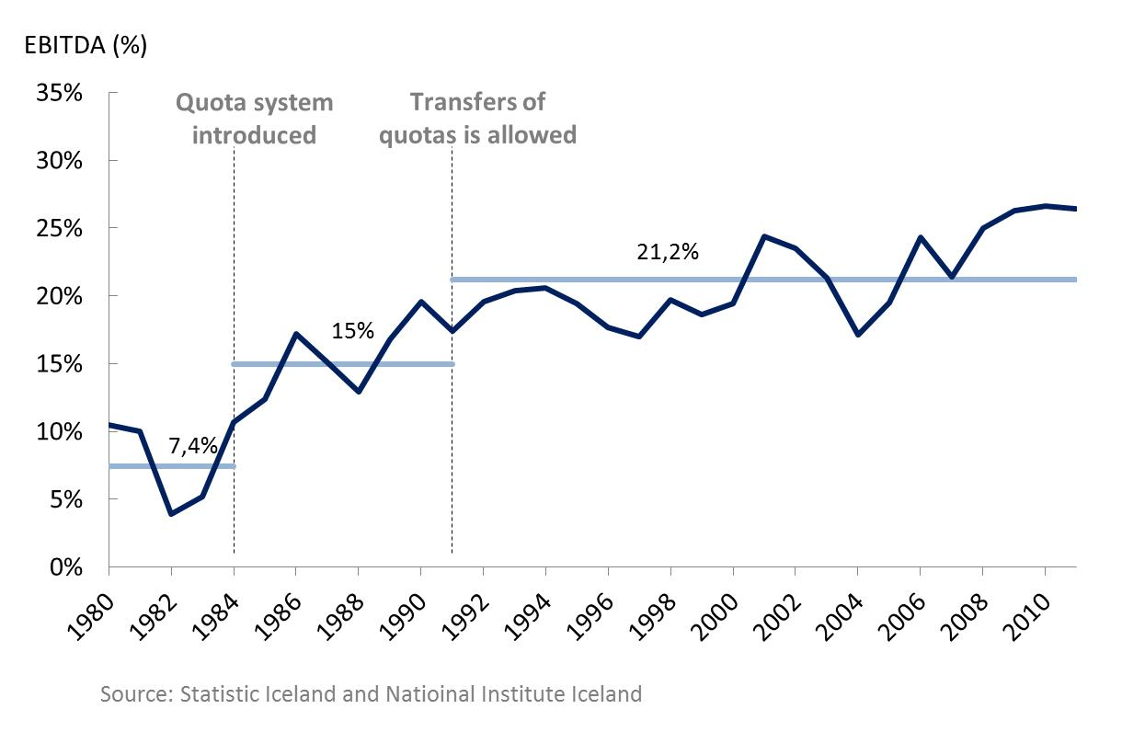
Developments 2012-2013: The Fisheries Sector
The fishing industry is among the most productive industries in the economy and highly competitive in international perspective
  Previous Government submitted a legislative proposal to change the fisheries system and implement additional fees 2012.
  New Government has already set forth a legislative proposal to change it.

Slide 9
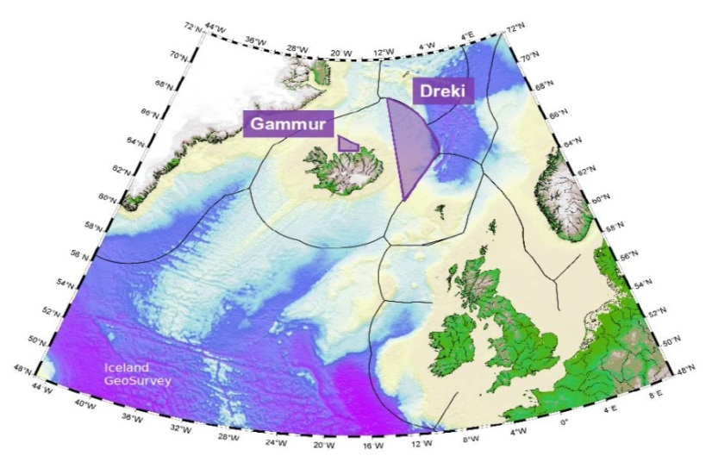
Developments 2012-2013: The energy sector
Renewable energy is one of Iceland’s core strength. Energy production has enabled the country to attract energy intensive industries
  The National Energy Authority has issued two licenses for exploration and production of hydrocarbons in the Dreki Area and one application is pending.
  Aluminum is one of the main exporting sectors in Iceland along with fisheries and tourism.
  The export revenue of aluminum in 2012 was ISK 225 billion and it is estimated that around ISK 90-95 billion remains in the economy.
  It has been estimated that a 10 year cost of data center operations are the lowest in Iceland among leading countries in the field.
Iceland’s exploration area

Slide 10
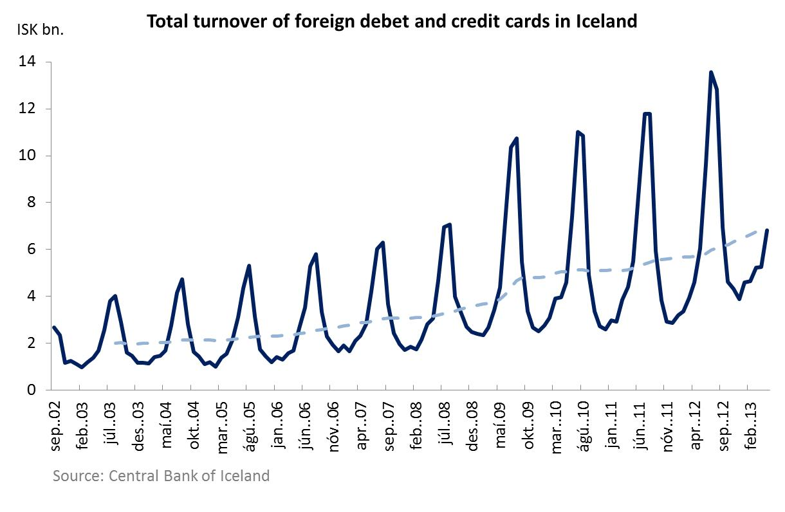
Developments 2012-2013: Economy and the Business Sector
The tourism sector has been booming since the collapse of the krona and is now one of the three main export sectors in Iceland
  Between 2009 and 2012 the number of tourists increased by 36%, or roughly 11% a year.
  Total inbound tourism consumption increased by 48% over the same time period.

Slide 11
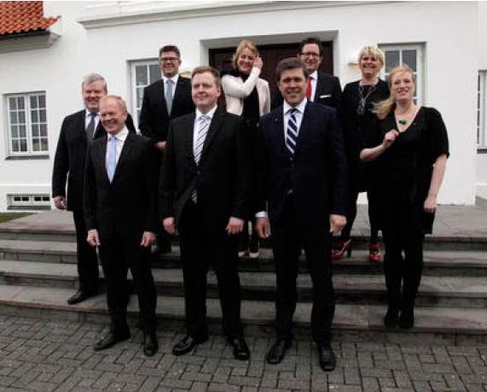
Developments 2012-2013: The Public Sector
In May 2013 after the elections a new government was formed between the Independence Party and the Progressive Party
  The Government has announced that it will:
  Simplify and lower taxes
  Set up a Consolidation Committee to address the budget deficit
  Lower household debt
  Postpone the negotiations with the EU

Slide 12
Overview
  1. Part A – Developments 2012-2013
  2. Part B – The Economic Landscape
  3. Part C – Developments 2009 - 2012
  4. Part D – Future prospects

Slide 13
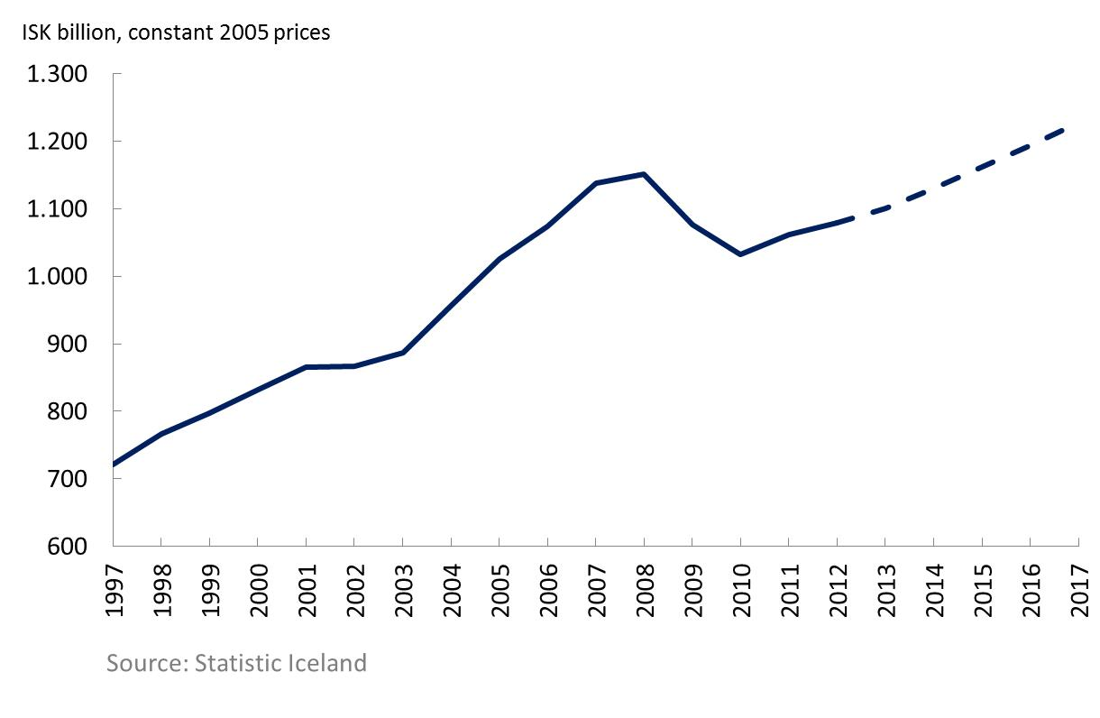
The Economic Landscape - GDP
After a sharp decrease in GDP following the collapse of the banking sector Iceland’s economy is back on a positive growth track
  The GDP dropped by 10.4% between 2008-2010 and is now roughly at it’s 2006 level.
  It is projected that it will reach it’s pre-recession peak in 2015

Slide 14
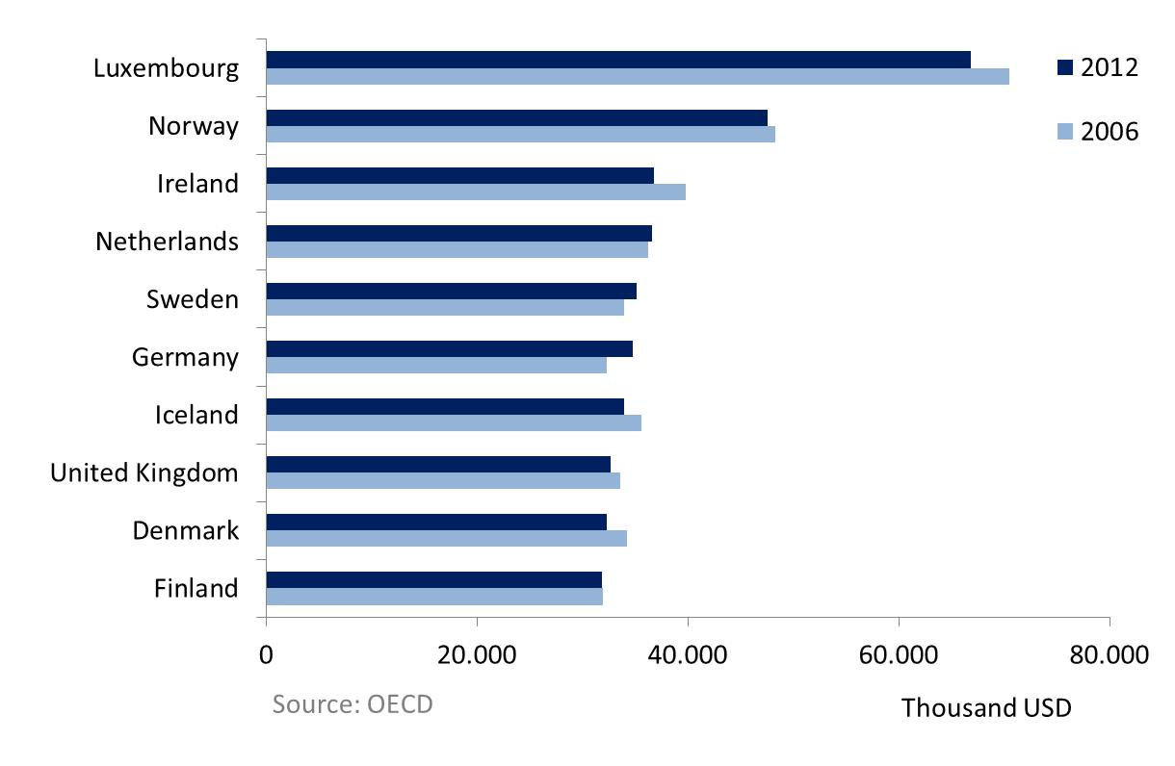
The Economic Landscape - GDP
Iceland’s living standards remain fairly high in international context, measured by PPP adjusted GDP per capita
  Iceland ranks 12th among OECD countries measured by PPP adjusted GDP per capita
  Living standards remain close to Iceland’s neighboring countries

Slide 15
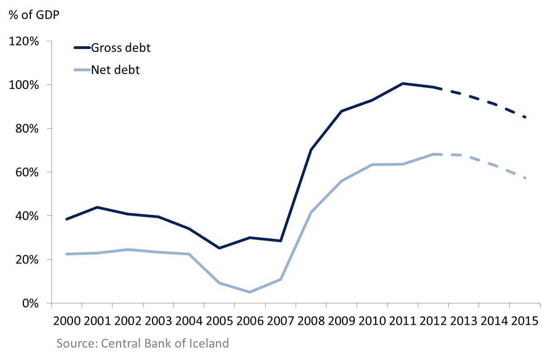
The Economic Landscape – State Debt
State debt increased dramatically in 2008 and still remains high. The ratio is predicted to decrease in coming years mainly due to increase in GDP
  Gross public debt is currently close to 100% of GDP
  As the Government holds more assets than pre-crisis, the difference between gross and net debt has increased

Slide 16
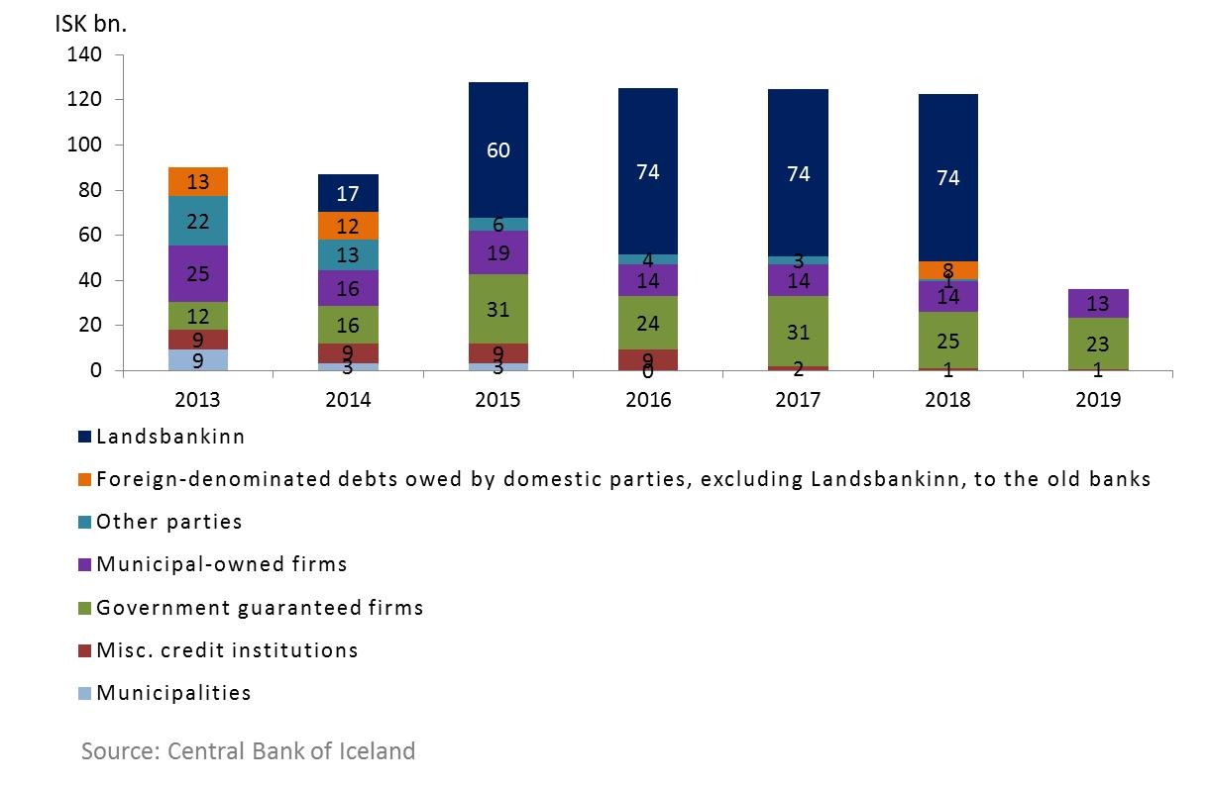
The Economic Landscape – State Debt
Scheduled repayments of foreign loans beyond Treasury indicate that repayments will be steep in 2015 and 2016
  Largest component in the aggregated repayment schedule is a bond between Landsbanki and its foreign creditors
  Additionally, publically owned energy companies have significant amounts outstanding

Slide 17
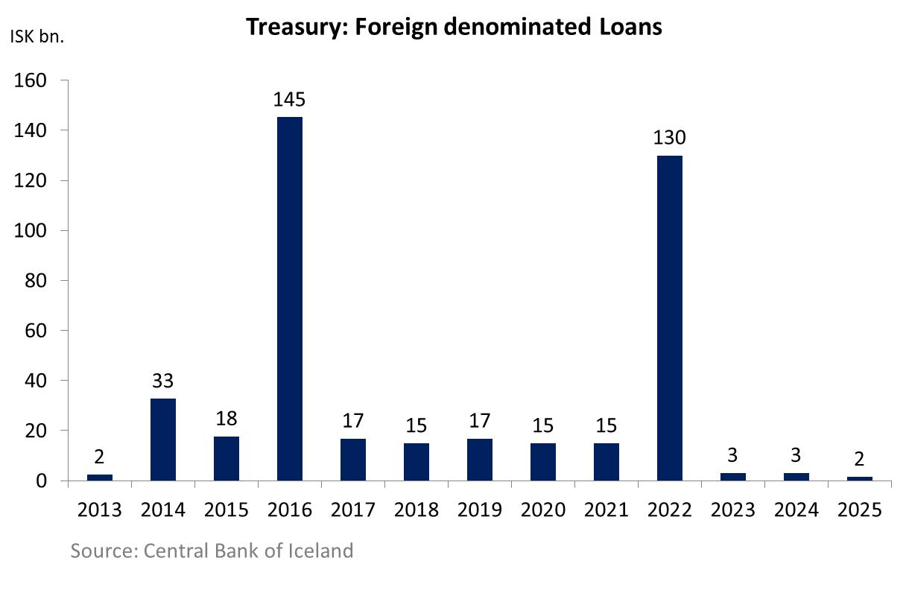
The Economic Landscape – State Debt
Scheduled repayments of the Treasury indicate significant burden in 2016
  Despite its debt burden, the Government has successfully secured foreign denominated funding on international markets post-crisis

Slide 18
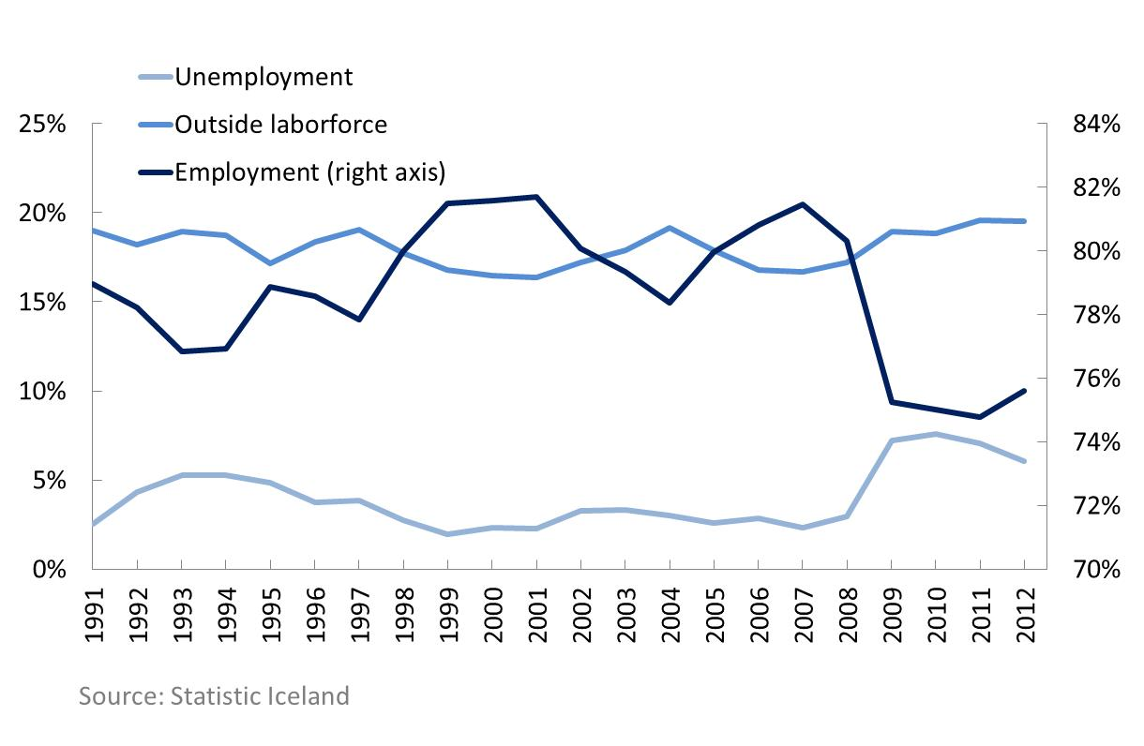
The Economic Landscape – Households and Corporations
Although unemployment has reduced from its peak, it has not been sufficiently driven by new job creation
  Unemployment reached its peak in 2010
  Although some of the reduction in unemployment can be attributed to new job creation, a larger part of it is driven by individuals leaving the labor market

Slide 19
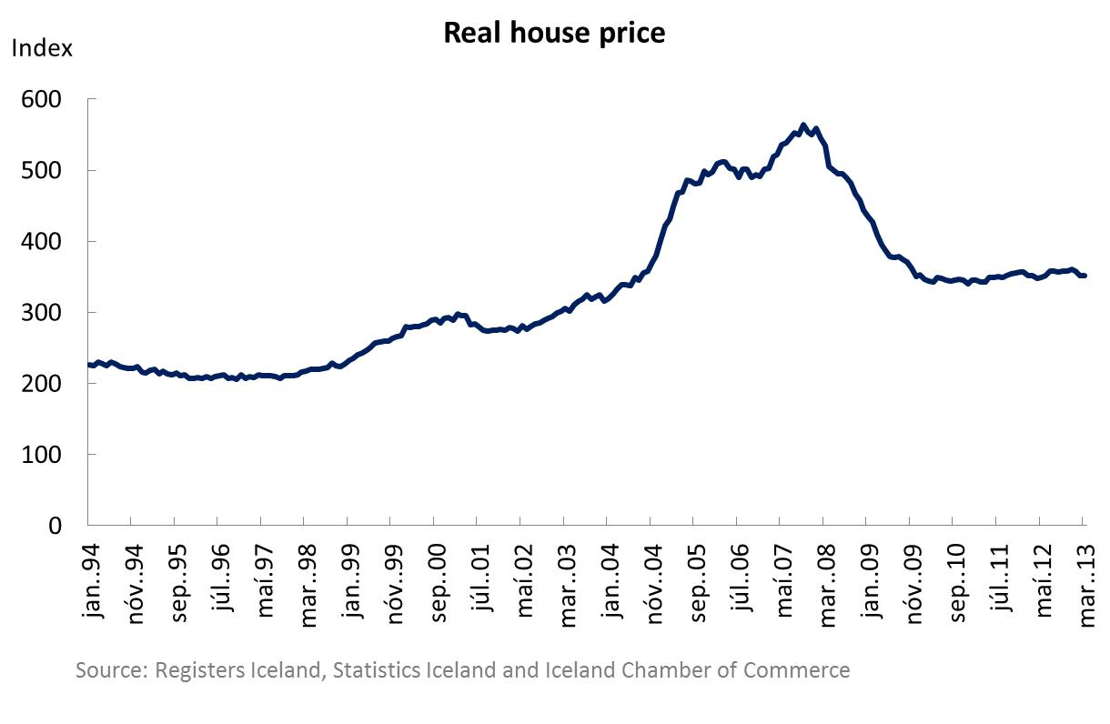
The Economic Landscape – Households and Corporations
Following a sharp drop in value, the real estate market is back on a recovery path
  Real house prices have dropped by a third from its peak in 2007
  Housing market has stabilized and is currently close to late 2004 levels

Slide 20
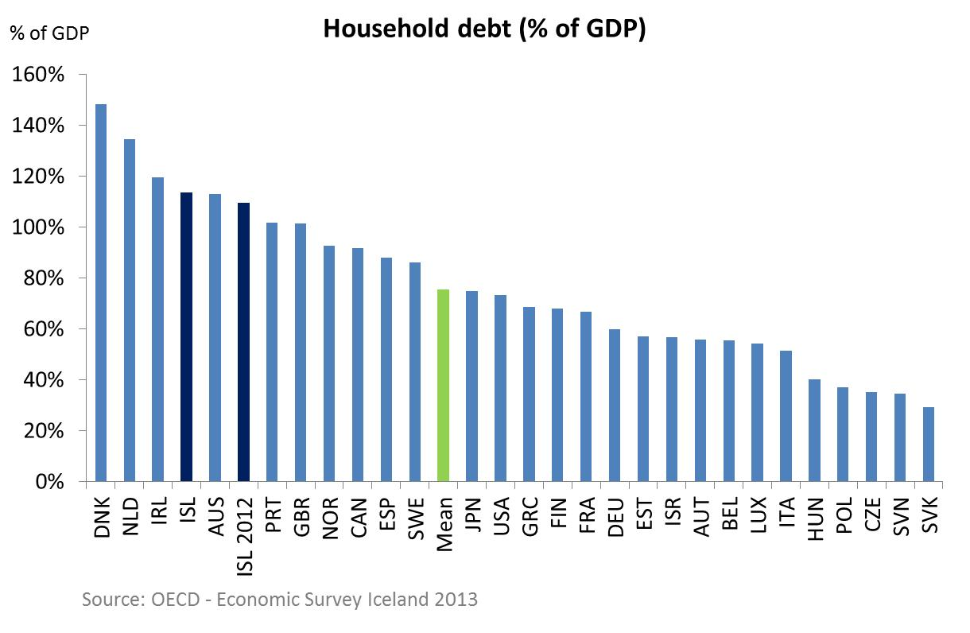
The Economic Landscape – Households and Corporations
Household debt level is considered sustainable, although it is high in international comparison
  Current household debt in Iceland is approximately 115% of GDP compared to an OECD mean of approximately 75%

Slide 21
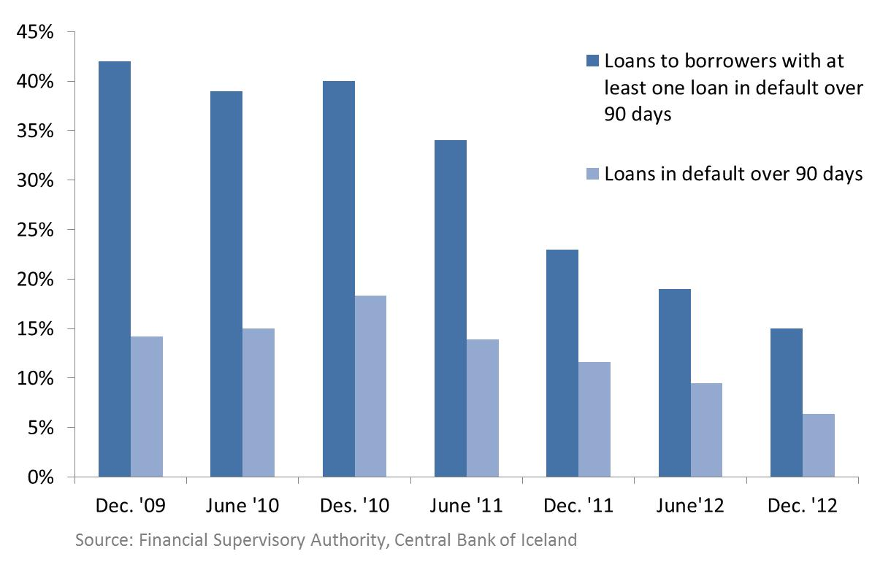
The Economic Landscape – Households and Corporations
Although still high in historical context, loan defaults have decreased substantially since 2009
  Debt restructuring has proven successful and non-performing loans have reduced by more than half

Slide 22
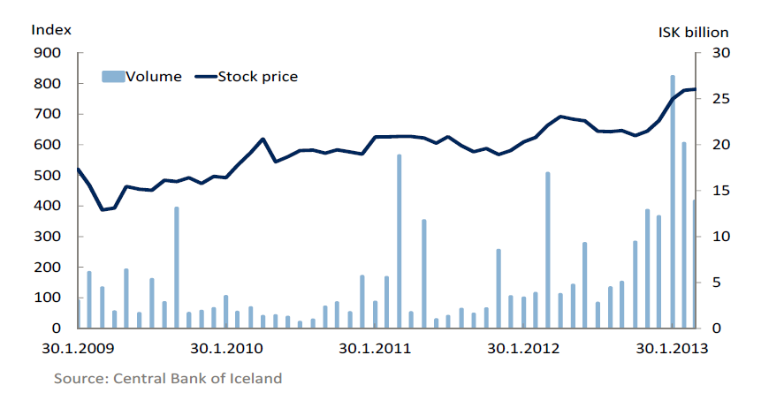
The Economic Landscape – Stock Market and Pension System
Stock market volume and returns indicate increasing appetite from investors for equity
  The stock market is still small compared to pre-crisis level in terms of volume and aggregated market cap
  However, new listings have picked up and volume is gradually increasing

Slide 23
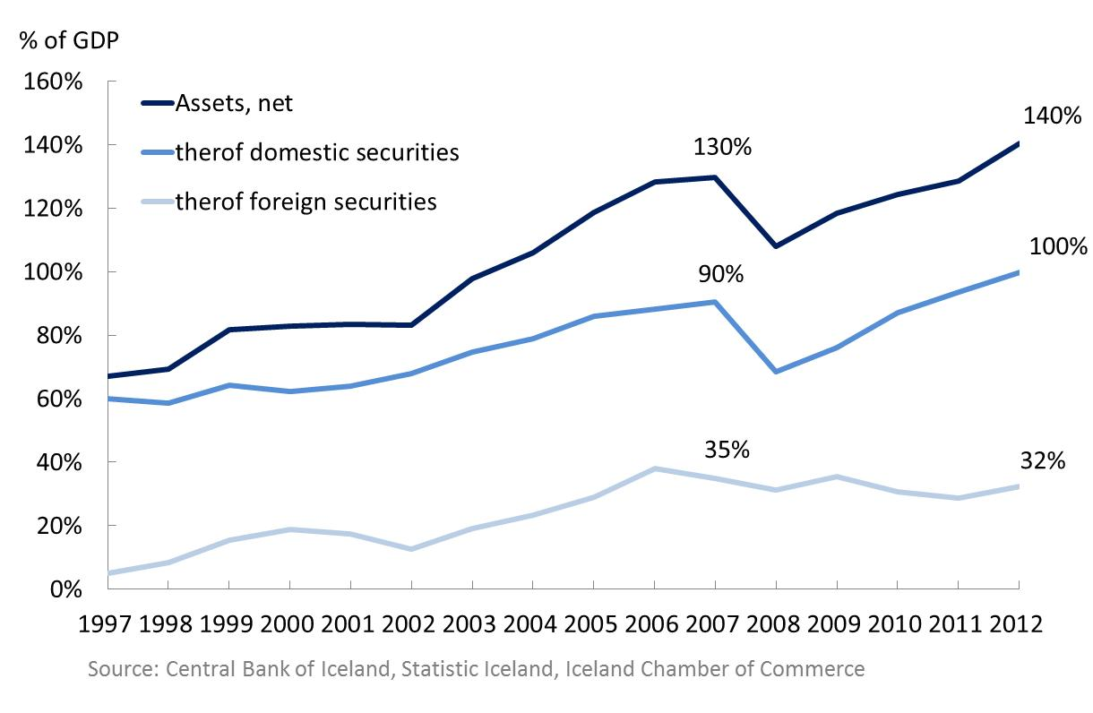
The Economic Landscape – Stock Market and Pension System
Net assets of the pension system have increased above pre-crisis level.
  Aggregated assets of Iceland’s pension system are among the highest in the world, reaching approximately 140% of GDP in 2012
  Foreign securities remains only 32% of total assets, well below the 50% maximum.

Slide 24
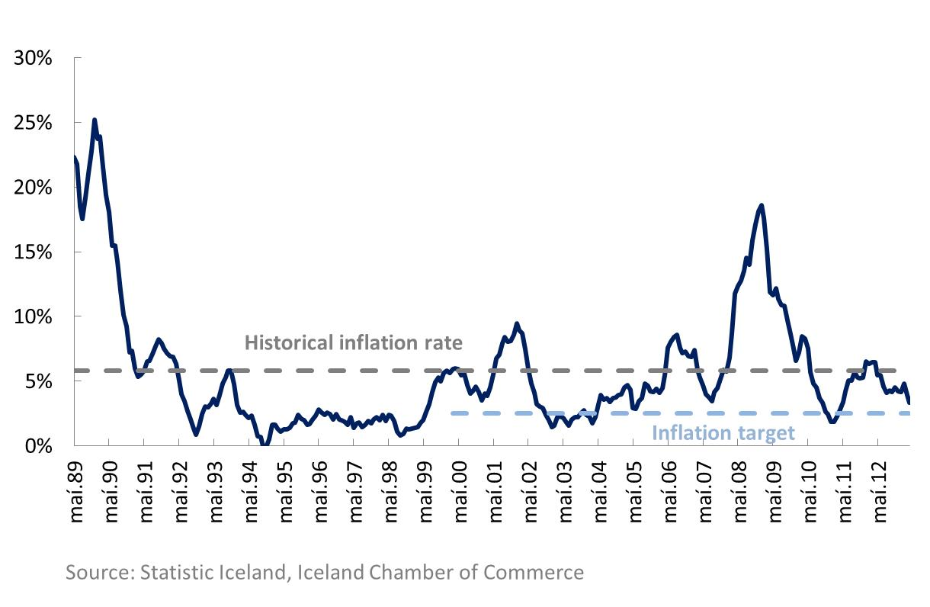
The Economic Landscape – Monetary Policy
Inflation is currently coming close to its targeted level of 2,5% after a long period well above the target.
  Inflation reached a peak following the crisis at close to 18%
  Prices have gradually stabilized, although the inflation rate has remained above CB’s target

Slide 25
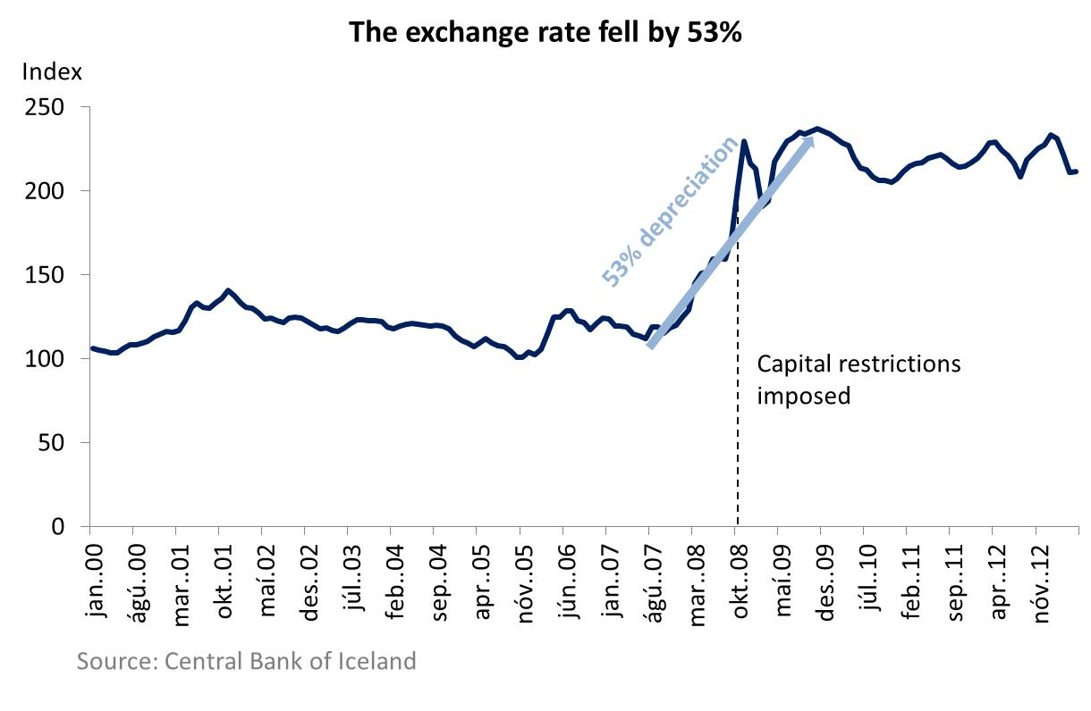
The Economic Landscape – Monetary Policy
After a sharp depreciation the exchange rate has remained fairly stable over the past three years.
  The ISK depreciated by 53% over a 28 month period in 2007-2009
  The current capital restrictions hinder the krona from depreciating further.
  The exchange rate has significant impact on the inflation rate.

Slide 26
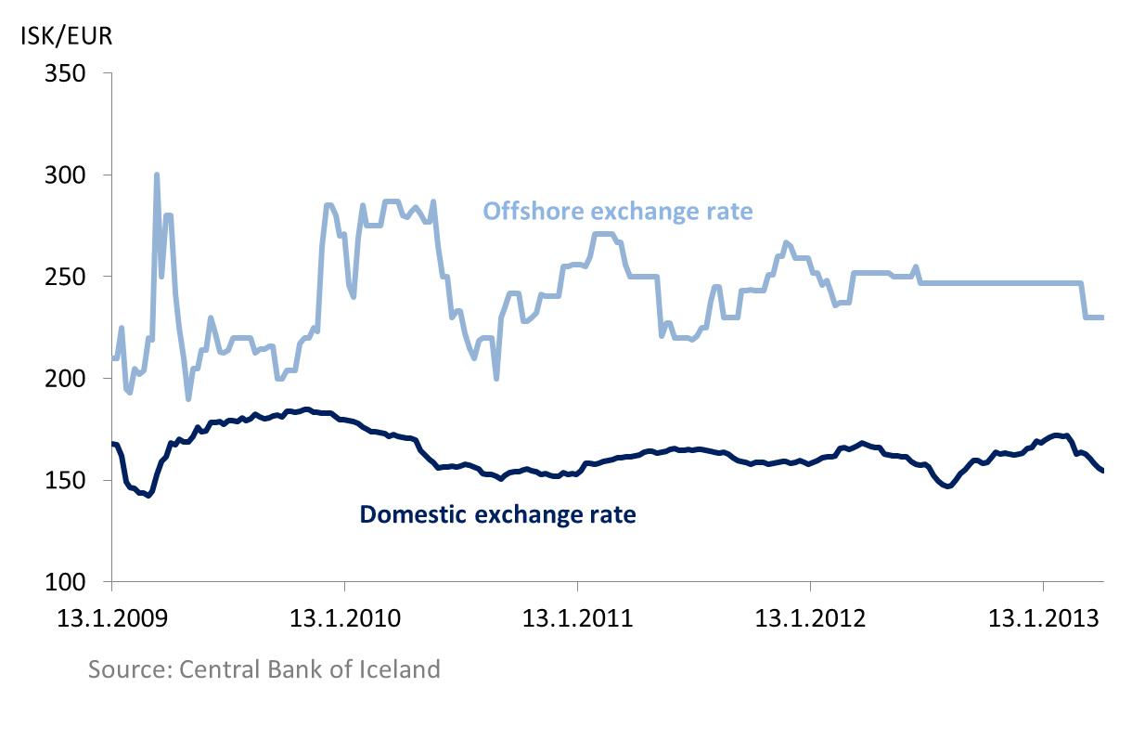
The Economic Landscape – Monetary Policy
Due to the capital restrictions there are effectively two different exchange rates on the krona, offshore and onshore/domestic.
  Domestic exchange rate has remained fairly stable
  Price formation of the offshore exchange rate is limited but gives an indication that divergence still exists between the domestic and international value of the ISK

Slide 27
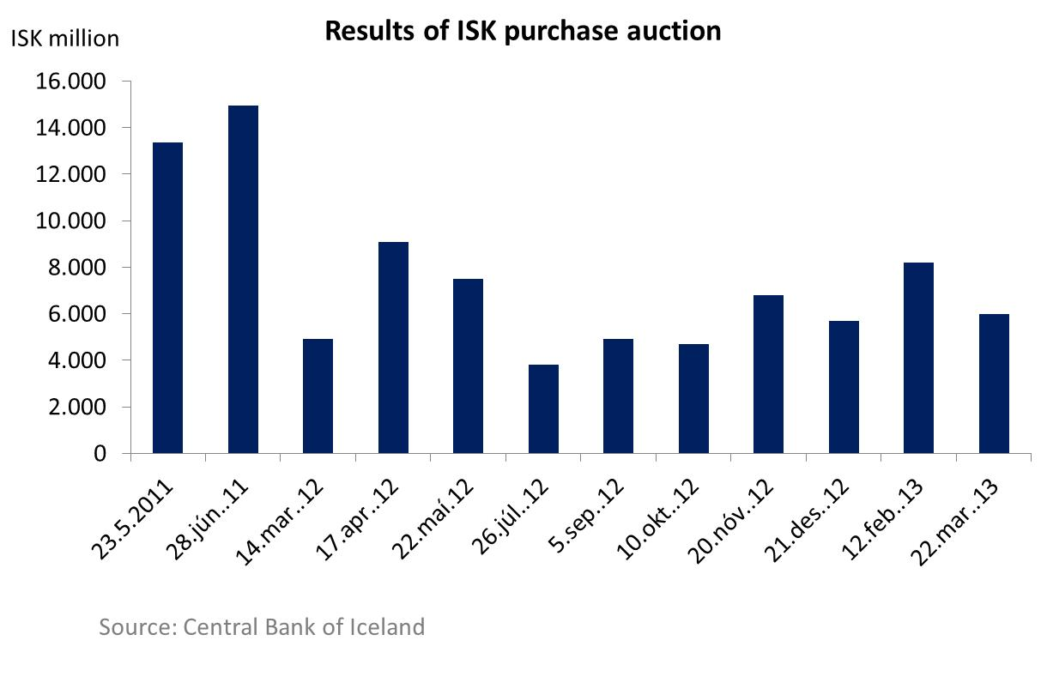
The Economic Landscape – Monetary Policy
In order to reduce pressure from volatile krona assets the Central Bank has held several ISK purchase auctions.
  The central bank estimates that volatile krona assets are equal to 22% of GDP or ISK 367 billions.
  By buying and selling ISK simultaneously, the Central Bank is swapping volatile capital for long term investors

Slide 28
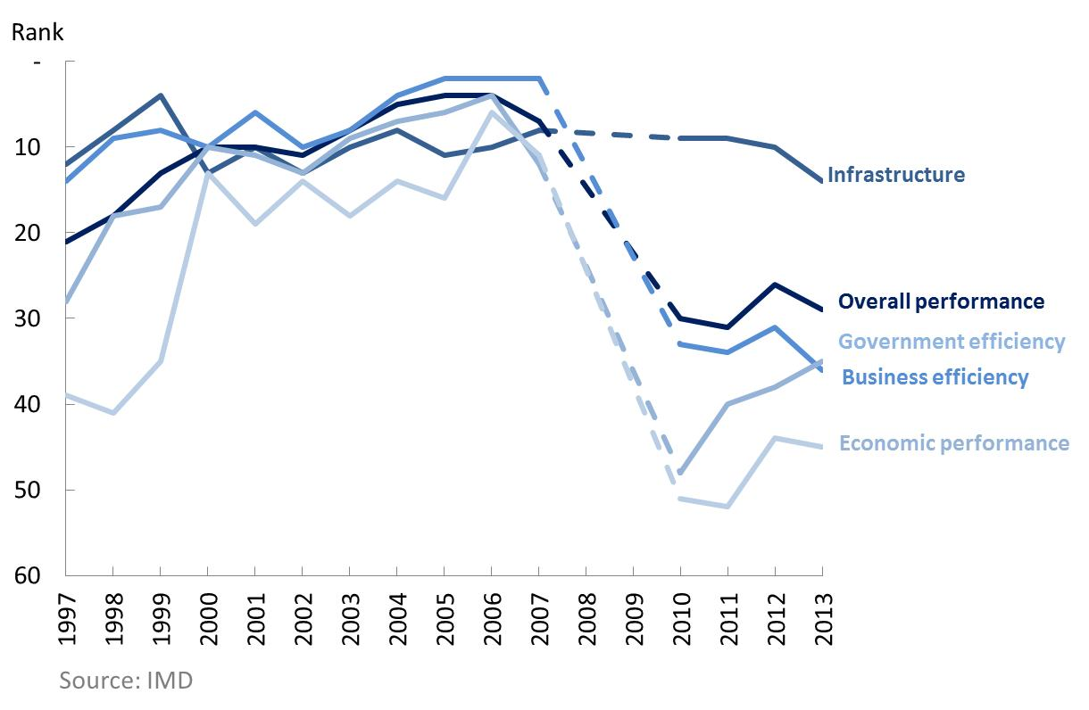
The Economic Landscape – Competitiveness
The competitiveness of the Iceland’s economy has decreased and is currently ranked no. 29 out of 60 countries.
  Overall performance has slightly improved over the past three years
  Significant improvement has taken place in business efficiency and economic performance, but these have been counterbalanced by reduction in government efficiency

Slide 29
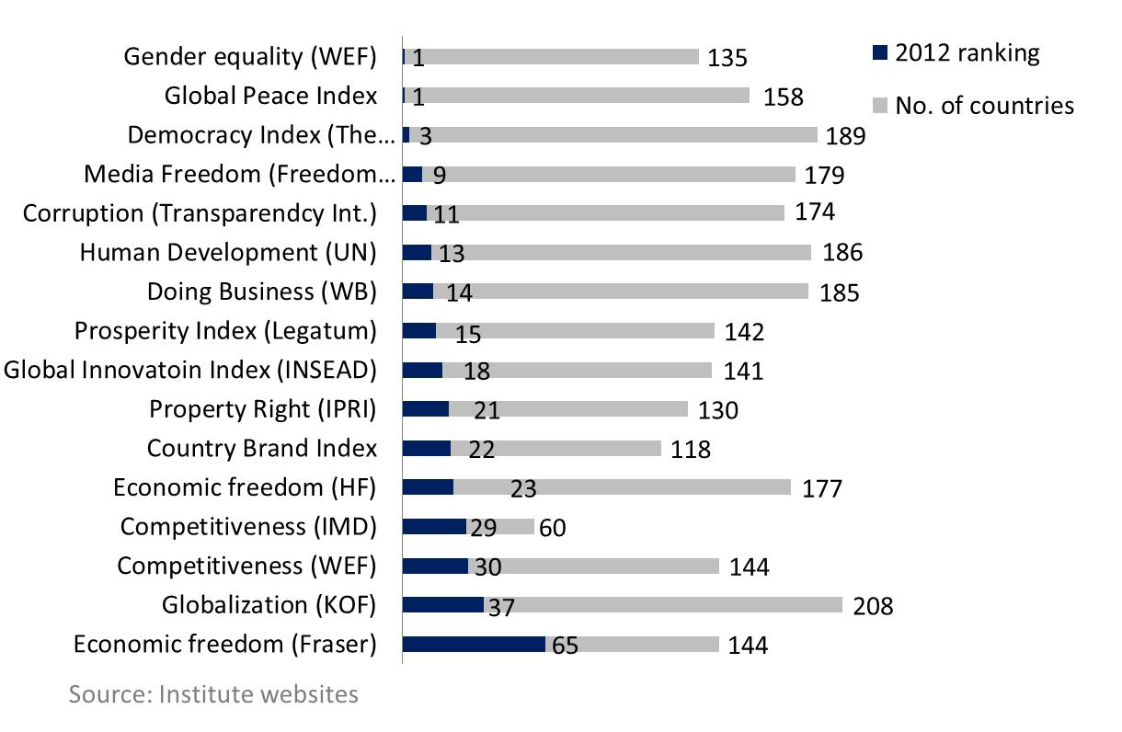
The Economic Landscape – Competitiveness
Nonetheless, Iceland remains high on various indexes, showing its resilience despite the deep recession.
  Gender equality and peace index are ranked highest in the world
  Several other social parameters are among the highest in the world
  The economic challenges have pulled down Iceland’s ranking on competiveness standards

Slide 30
Overview
  1. Part A – Developments 2012-2013
  2. Part B – The Economic Landscape
  3. Part C – Developments 2009 - 2012
  4. Part D – Future prospects

Slide 31
Developments 2009-2012
  After the collapse new equity was need to finance the Housing Financing Fund. The fund has received a total of ISK 46 bn.
  The Government set up a Banking agency, Icelandic State Financial Investments in august 2009. Its main objects is to control the State’s holding in financial undertakings
  The EFTA Court ruled that the Icelandic government was not obligated to repay UK and the Netherlands because of the online savings banks Icesave.
  IMF completed the 6th and the final review of Iceland’s economic performance in august 2012 making Iceland the first industrialized country to complete such a program
  On June 9th 2011 Iceland issued USD 1 billion worth of bonds due in 2016
  The Central Bank introduced in 2011 a new plan on capital controls, called the Investment Program
  In April 2010 the Special Investigation Committee delivered its report on whether any public officials were responsible for misconduct

Slide 32
Overview
  1. Part A – Developments 2012-2013
  2. Part B – The Economic Landscape
  3. Part C – Developments 2009 - 2012
  4. Part D – Future prospects

Slide 33
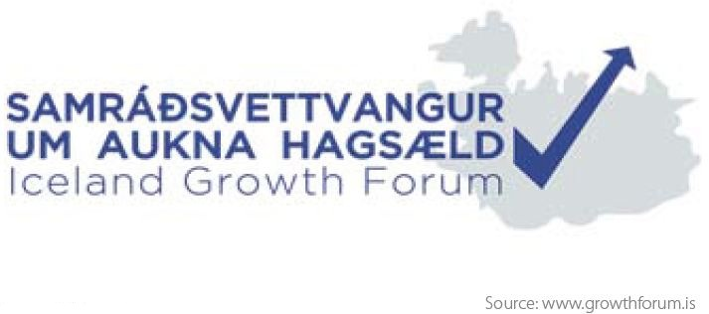
Future Prospects – Iceland Growth Forum
In short the Forum is a platform to promote factual discussion on ways to ignite long-term growth
The forum, which was set up in January 2013 by the Prime Minister’s office, consist of political leaders, representatives of the business community, public administration, academics and the labor market.
The economic goals set by the Forum:
Average GDP growth of 3,5% until 2030
Government debt below 60% of GDP before 2030
Price stabilization with average inflation 2,5% until 2030

Slide 34
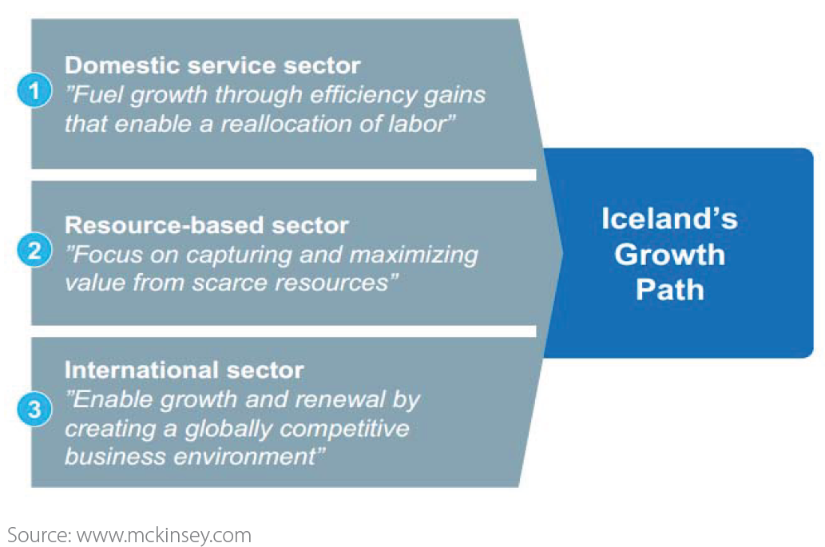
Future Prospects – The McKinsey & Company Report
McKinsey & Company published a report in October 2012 ,,Charting a Growth Path for Iceland”.
The report’s main messages are that Iceland productivity lags behind our peer nations. McKinsey split the Icelandic economy into three main sectors:

Slide 35

Future Prospects – The Iceland Chamber of Commerce Action Handbook
In February 2013 the Iceland Chamber of Commerce published a report called The Action Handbook.
The Handbook introduces 13 initiatives to increase efficiency and productivity in the Icelandic economy.

Slide 36
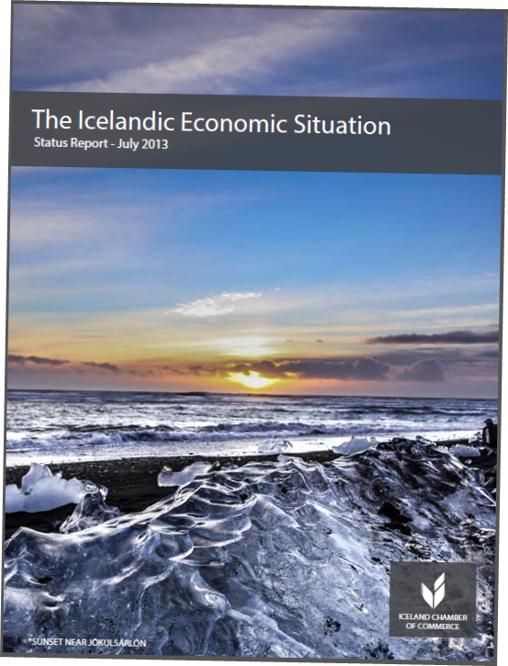
The Icelandic Economic Situation – Status Report
Although the global financial crisis hit Iceland’s economy relatively hard, it is gradually working its
way out of the recession. The economy is based on strong foundations and possesses strong growth opportunities going forward.
The society is dynamic and technology driven
with a young and well educated workforce.
The country has the privilege of abundant natural resources and its nature and culture has attracted an increasing number of tourists each year.
The full report with further details is available at chamber.is/statusreport.
A mailing list is available at chamber.is/mailinglist.

Slide 37
The Icelandic Economic Situation
The Icelandic Economic Situation
Status Report – July 2013
Status Report – July 2013

